Slide 1
18:00 🍕 Pizza, beer, drinks
18:30 📊 Adam Vesecký: Android vs Flutter - which is better from which aspects?
18:55 🖥️ Johannes Milke: Develop desktop applications with Flutter
19:20 📱 Vince Varga: Interaction between Flutter and native iOS or Android
19:45 💬 Open discussion
📍The event's location, food, and drinks are provided by codecentric AG.

Slide 2
Interactions between Flutter and native hosts
github.com/vargavince91/flutter-munich-april
Vince Varga • 4 April 2019, Munich

Slide 3
Overview
Platform channels
Event vs Method Channels
Create and Publish a Flutter plugin
Start an activity/view controller
Platform views
github.com/vargavince91/flutter-munich-april

Slide 4
Why?
You might face issues that you cannot solve only in Flutter
Access platform APIs
Leverage third party SDKs
Performance
Flutter is great for UI, Dart is a good language, but community is not that big
New features coming out on platforms (e.g. Android Q)

Slide 5
Packages and plugins
Packages enable the creation of modular code that can be shared easily.
Dart packages
General packages written in Dart
Private repo, local packages, etc… supported
Private pub server???
Plugin packages
A specialized Dart package which contains API written in Dart code combined with a platform-specific implementation for Android (using Java or Kotlin) and/or for iOS (using Objective-C or Swift)

Slide 6
Platform channels
Messages are passed between the client (UI) and host (platform) using platform channels
The Flutter portion of your app sends messages to its host, the iOS or Android portion of your app, over a platform channel.
The host listens on the platform channel, and receives the message. It then calls into any number of platform-specific APIs—using the native programming language—and sends back a response to the client, the Flutter portion of your app.

Slide 7
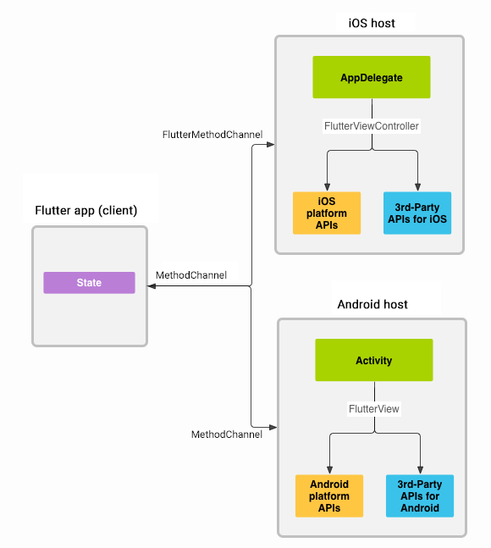
Platform channels
Easy to establish these channels on Flutter projects.
You can send numbers, strings, booleans, lists, maps, byte arrays
The serialization and deserialization of these values to and from messages happens automatically when you send and receive values.
Setup is slightly different in plugins and in apps, but principles are the same

Slide 8
Platform channels: Method and event channels
Method Channels when
You have to call a function once and you receive the result once
When you can repeat the first item (focus on: Dart knows when to fetch the results again)
Event channels when
Need to pass results continuously from platform to Flutter
Only the host knows when new events are triggered:
Sensor information
Anything with listeners
Esptouch example

Slide 9
Code example: Method channels
class AndroidWifiInfo {
static const _channelName = 'eng.smaho.com/android_wifi_info';
static const MethodChannel _channel = const MethodChannel(_channelName);
static Future<bool> get ssidHidden {
return _channel.invokeMethod('ssidHidden');
}
static Future<int> get linkSpeed {
return _channel.invokeMethod('linkSpeed');
}
static Future<String> get ssid {
return _channel.invokeMethod('ssid');
}
}

Slide 10
public class AndroidWifiInfoPlugin implements MethodCallHandler {
public static void registerWith(Registrar registrar) {
final MethodChannel channel =
new MethodChannel(registrar.messenger(), channelName);
channel.setMethodCallHandler(new AndroidWifiInfoPlugin(registrar));
}
private AndroidWifiInfoPlugin(Registrar registrar) {
this.registrar = registrar;
}
@Override
public void onMethodCall(MethodCall call, Result result) {
switch (call.method) { // and many more cases
case "ssidHidden": ssidHidden(call, result); return;
default: result.notImplemented(); break;
}
}
private void ssidHidden(MethodCall call, Result result) {
result.success(wifiInfo.ssidHidden());
}
}

Slide 11
Before you write platform channels...
Do you have to write platform channels?
Check existing plugins. New plugins supported features on different platforms are released, so what’s not supported today, could be supported in a month.
Maybe you don’t even need to go to the platform
Think about what you need to pass between the platforms
Instead of bytestreams of images, can you just send a source and destination file name?

Slide 12
When working with plugins and writing platform channels
Run/ write example app
MQTT, QR readers...
Assume existing plugins are not always complete
Connectivity BSSID
Use IDEs for each platform (at least in the beginning)
Xcode for Objective-C, Swift
Android Studio for Java, Kotlin
Dart

Slide 13
Publishing on Dart Pub
Steps
Create plugin using flutter create
Need to specify that you create a plugin
Set Project name and organization
Set iOS and Android language
Implement minimum useful features
Clean up: changelog, unit tests, README
pub publish --dry-run
Add author to pubspec.yaml
pub lish (or pub publish)
DONE!

Slide 14
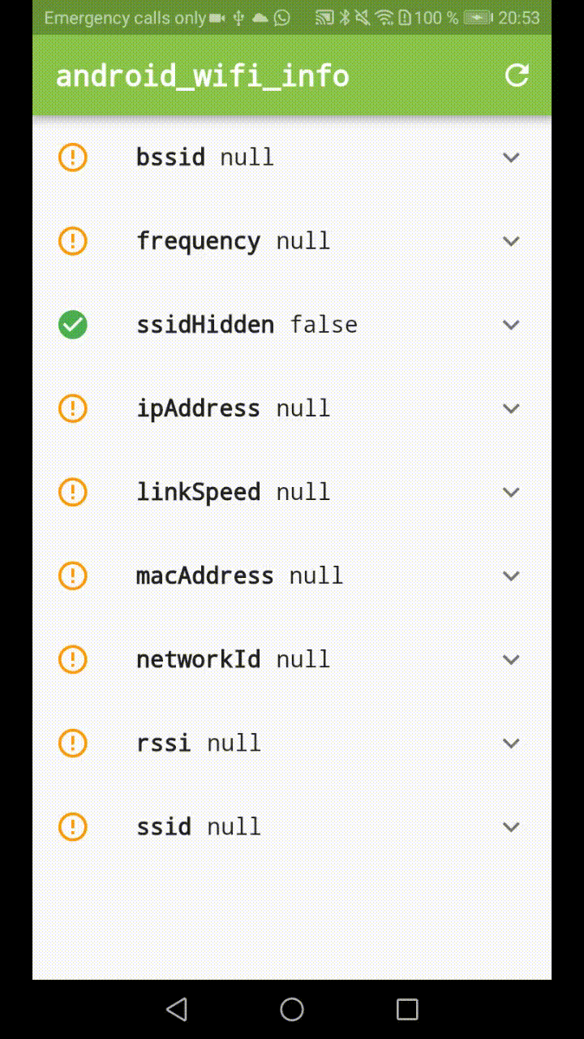
Plugins for only one platforms
Provide a nice interface from Dart
Solve the problem once
Creating a plugin requires some boilerplate
No real type safety while passing parameters and invoking methods
You can combine two plugins to make a cross-platform plugin

Slide 15
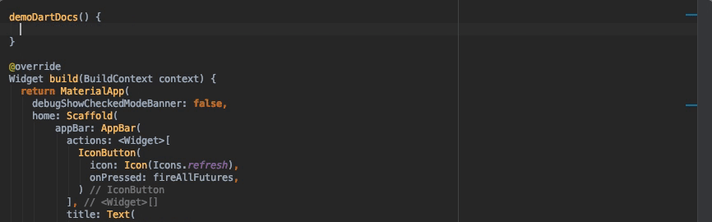
Plugins for only one platforms

Slide 16
Combine plugins
import 'dart:io';
import 'package:android_wifi_info/android_wifi_info.dart';
import 'package:ios_network_info/ios_network_info.dart';
get bssid {
if (Platform.isAndroid) {
return AndroidWifiInfo.bssid;
} else if (Platform.isIOS) {
return IosNetworkInfo.bssid;
}
throw Exception('WiFi BSSID is not supported on this platform');
}

Slide 17
Just start an activity...
You need to do something that you know how to do in Java/Kotlin/Objective-C/Swift.
We know we can pass information from the Dart code to the platform-specific code and receive some result using method channels.
You can call an activity or view controller.

Slide 18
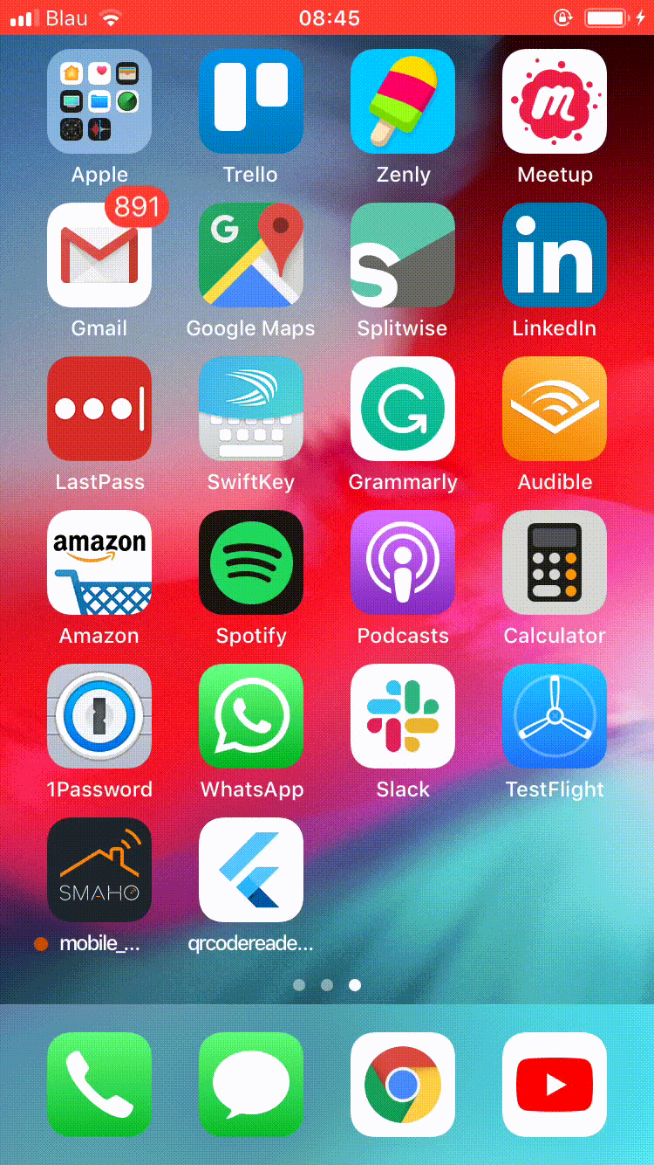
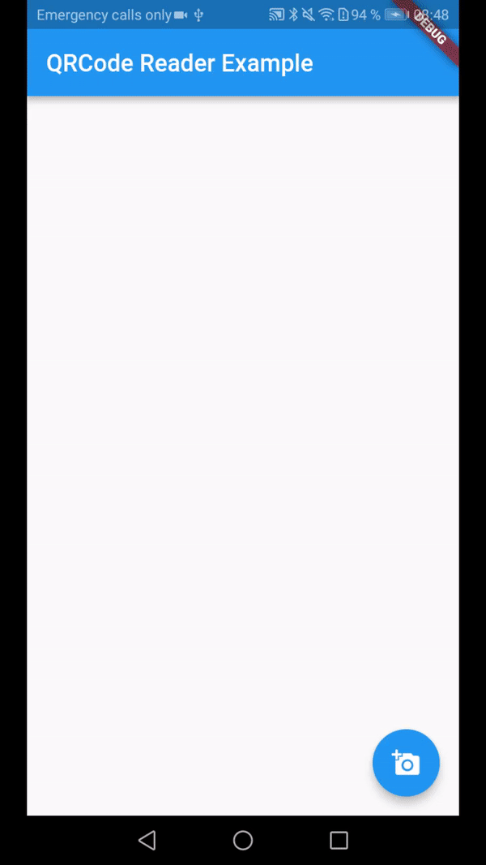
QR code reader

Slide 19
Start an activity
From Dart, you just invoke a method
static const _channelName = 'com.example/something'
static const MethodChannel _methodChannel =
MethodChannel(_channelName);
final int result =
await _methodChannel.invokeMethod('doSomething', input);

Slide 20
Start an activity
Get arguments. Start activity for result. Send result Back
// In method call handler
int value = methodCall.arguments();
if (methodCall.method.equals("doSomething"))
launchActivity(value);
// In your class
private void launchActivity(int value) {
Intent fullScreenIntent = new Intent(this, ValueActivity.class);
fullScreenIntent.putExtra(ValueActivity.VALUE, value);
startActivityForResult(fullScreenIntent, VALUE_REQUEST);
}
@Override
protected void onActivityResult(int requestCode, int resultCode, Intent data) {
// check request and result code, then...
result.success(data.getIntExtra(ValueActivity.VALUE, 0));
}

Slide 21
Platform Views: AndroidView and UIKitView
Embed an Android or iPhone platform control in a Flutter app. Platform view widgets are just widgets: you can compose them as any other widgets.
Last resort: shouldn’t use it unless you have to.
I didn’t have to work with it yet, but want to mention so that you know what to look up…
Google Maps and WebView

Slide 22
Thank you all for coming!

Slide 23
Upcoming events
Presentations for June?
Coding night in July
Flutter Stories in August

Slide 24
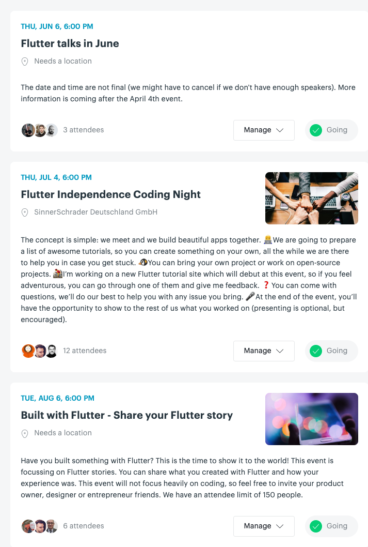
We need speakers!
Hands-on coding event
Flutter Stories

